Slide 1
C2 server
Command and control server

Slide 2
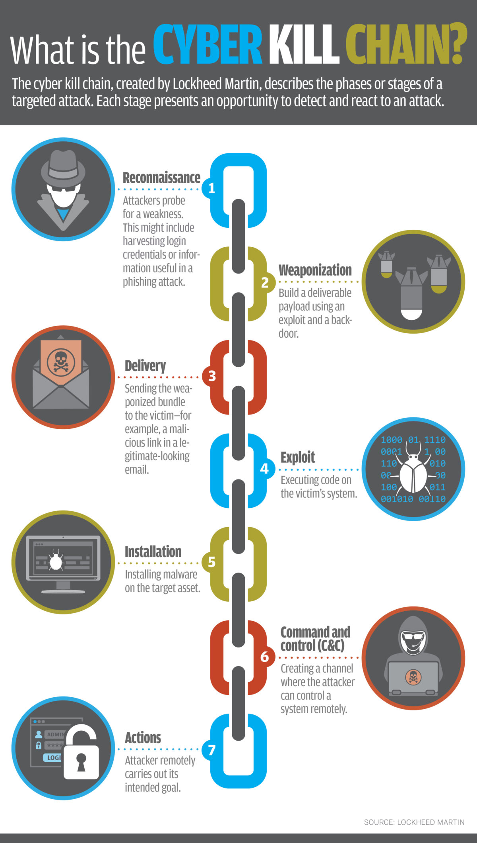
Why C2?
The 6th phase is C2/CNC
Persistency
Objectives and actions
Post exploitation

Slide 3
C2 features
Connection with the payload – Bind or reverse bind
2. Encryption and protocol for connection
3. Logging
4. Pre built commands or scripts
5. GUI and graphs
6. Automation

Slide 4
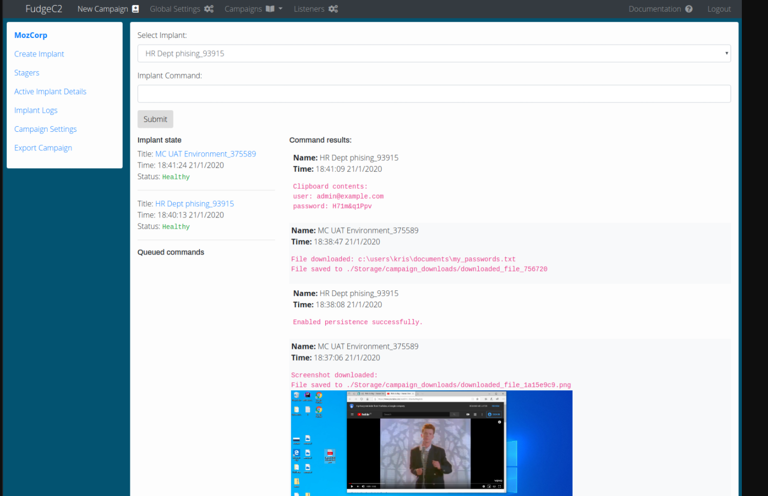
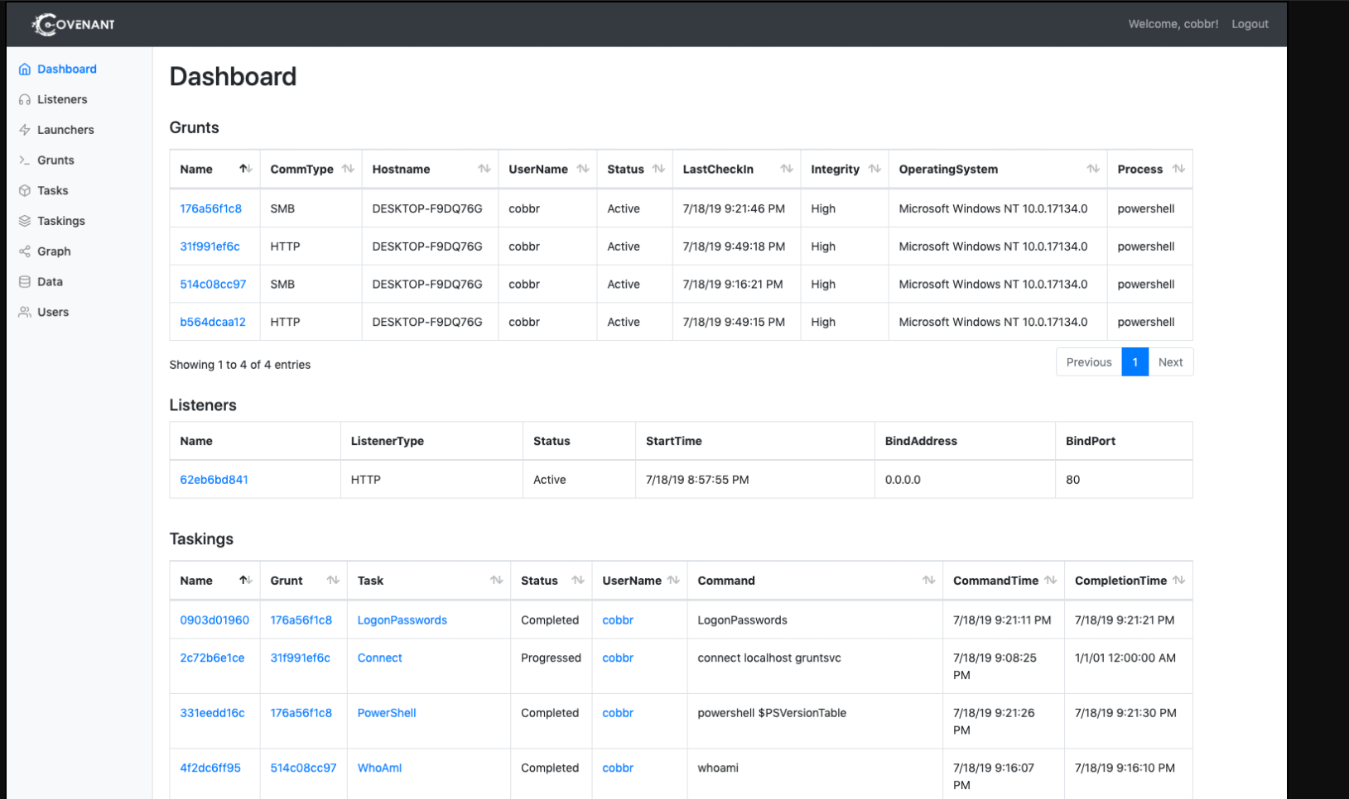
C2 in the open internet
We can see very less C2 on internet since it gets blacklisted as soon as it gets detected
Reverse engineering will give us the IP address even if the IP is dynamically generated
Most of the default C2 open sources are detected based on signatures

Slide 5
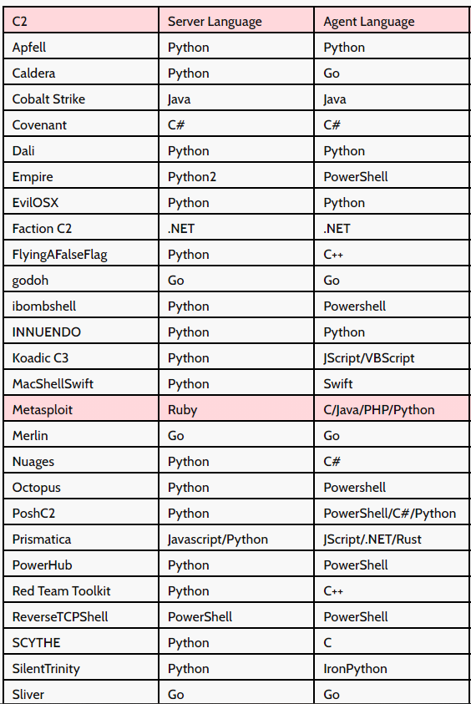

Some interesting C2 servers
Dali – image steg ( commands inside image)
Daa – discord server

Slide 6
References:
https://www.thec2matrix.com/matrix
https://www.thec2matrix.com/matrix
https://pentestit.com/list-of-open-source-c2-post-exploitation-frameworks/

Slide 7
Thank You 2

Slide 8
Customize this Template
Template Editing Instructions and Feedback

